Slide 1
LASER SECURITY SYSTEM USING ARDUINO

Slide 2
Group Members:
Shraddheya Kadam Omkar Thakare Suraj Mane
Amol Gole
Project Supervisor:
Prof. Deepak Kurule

Slide 3
Content
Introduction
Required Components
Schematic Diagram
Arduino Code
Working
Referenecs

Slide 4
Introduction
Our laser security system is designed in microcontroller based platform. Because microcontroller now brings a modern era to develop electronics project using a few component. Here we have used Arduino Uno R3 for this process. Arduino is now a popular microcontroller platform in the world.

Slide 5
Required Components
Arduino UNO
Laser Diode
Light Sensor (LDR Based)
Buzzer

Slide 6
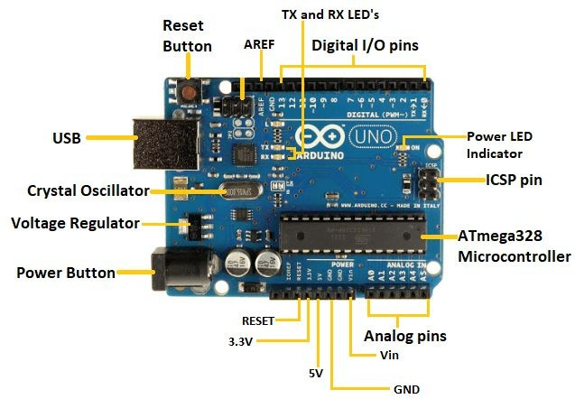
Arduino UNO
ATmega328 Microcontroller- It is a single chip Microcontroller of the ATmel family. The processor code inside it is of 8-bit. It combines Memory (SRAM, EEPROM, and Flash), Analog to Digital Converter, SPI serial ports, I/O lines, registers, timer, external and internal interrupts, and oscillator.

Slide 7
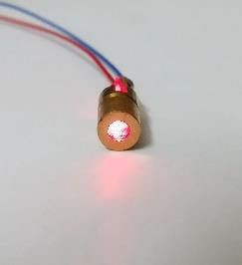
Laser Diode
A laser diode, (LD), injection laser diode (ILD), or diode laser is a semiconductor device similar to a light-emitting diode in which a diode pumped directly with electrical current can create lasing conditions at the diode's junction.Laser diodes can directly convert electrical energy into light.

Slide 8
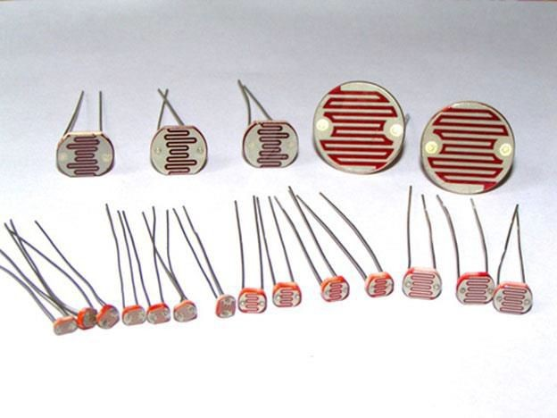
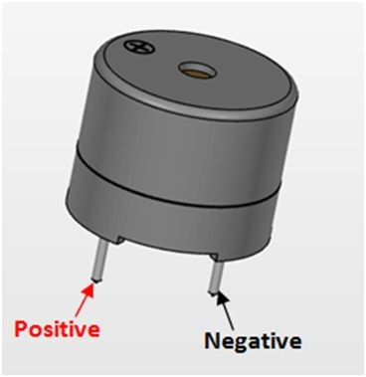
Light Sensor (LDR Based)
An LDR is component that has a resistance that changes with the light intensity that falls upon it.
This allow them to be used in light sensing circuits
Buzzer
A buzzer is a small yet efﬁcient component to add sound features to our project/system.

Slide 9
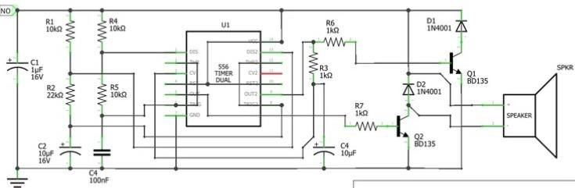
Schematic Diagram for LASER Security System

Slide 10

Arduino Code

Slide 11
Working
The project basically works on the principle of interruption. If by any means the laser light is interrupted the alarm will start unless it is reset with the pushbutton. The laser is a concentrated light source that puts out a straight beam of light of a single color.
The LDR is sensitive to light and puts out a voltage when the laser light hits it. When the laser beam is interrupted and can’t reach LDR, its voltage output changes, and eventually the alarm will ring.
In this system, there is an invisible LASER beam that is continuously ON and it is detected by light sensor. Whenever any object or person comes in between LASER and sensor the beam interrupts and the sensor does not detect LASER light. And As soon as the beam interrupts (cuts) the siren blows for intruder alert.

Slide 12
REFERENCES
The 8051 Microcontroller and Embedded Systems: Using Assembly and C.
Arduino : The Complete Beginner's Guide - Step By Step Instructions (The Black Book).
https://www.engineersgarage.com/
https://www.instructables.com/

Slide 13
Thank You

